Slide 1

Influencing Code and Policy
NW EcoBuilding Guild January 2026 Education Session
Rachel Koller, Managing Director, Shift Zero
Deepa Sivarajan, Washington Local Policy Manager, Climate Solutions

Slide 2
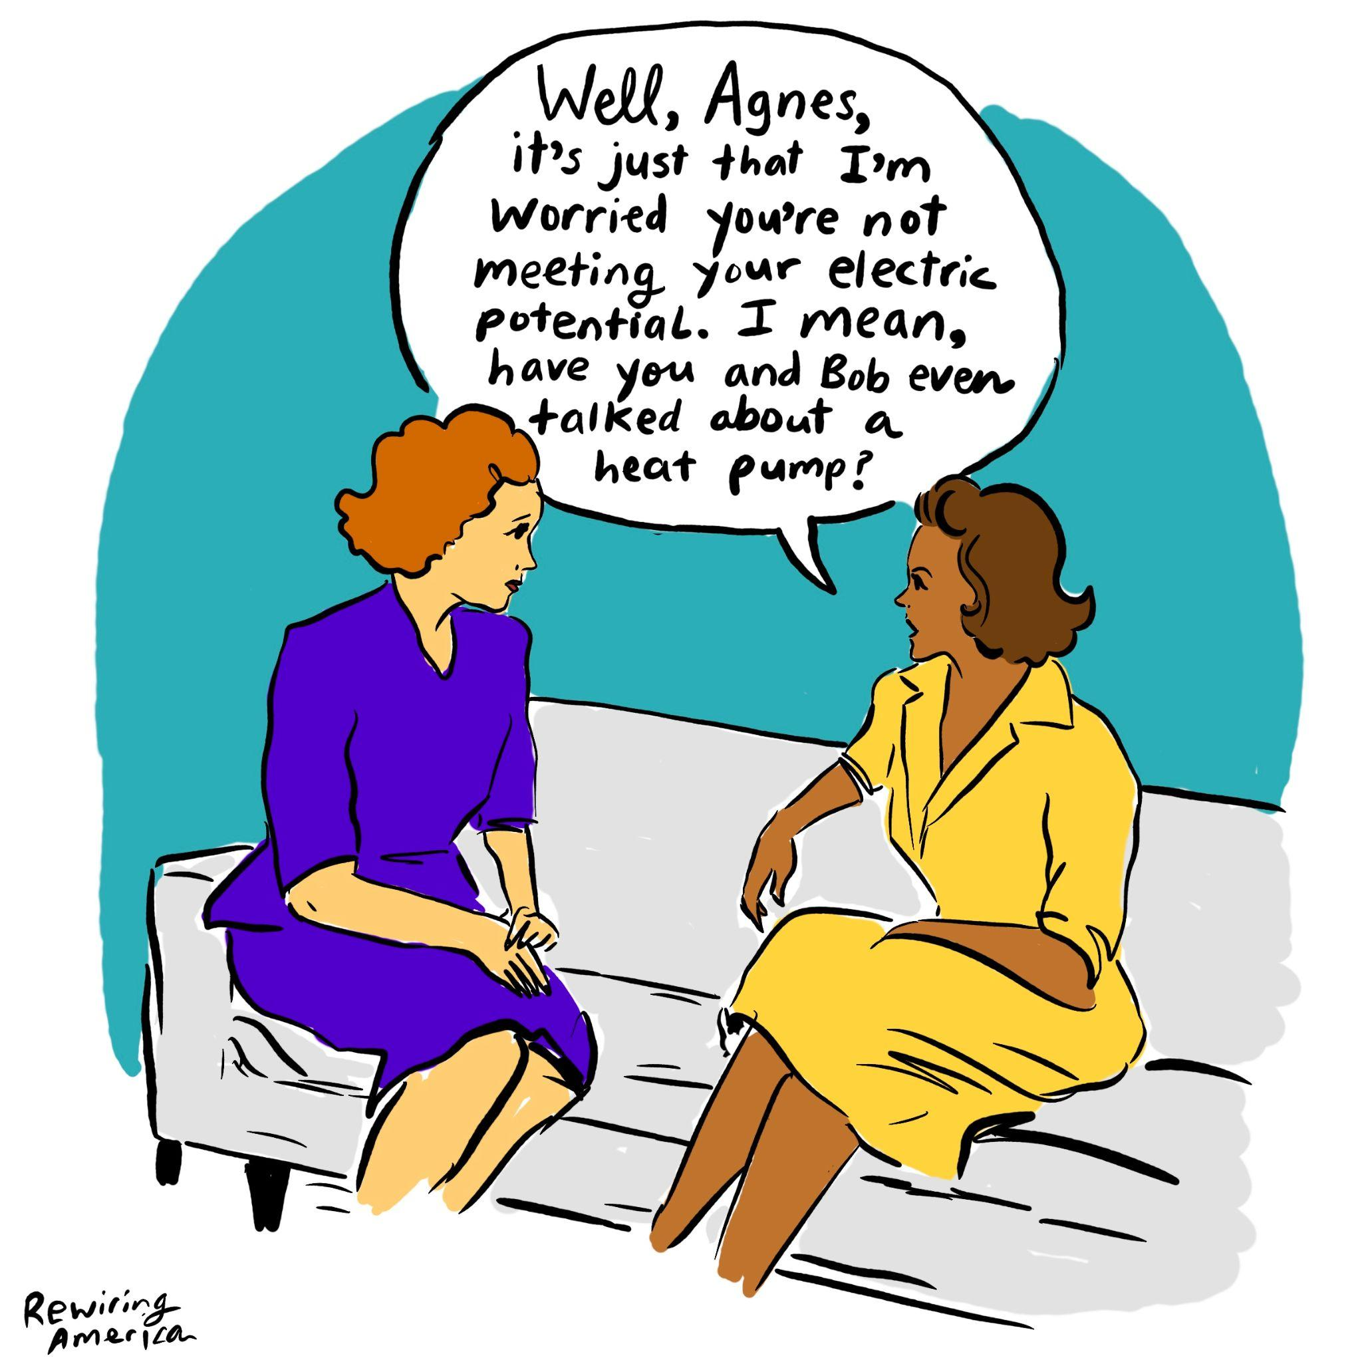
Agenda
Shift Zero Intro
Buildings & Washington’s Clean Energy Transition
2024 WA State Energy Code & IBC Update
Future of Code Advocacy
Legislative Session
Calls to Action
Q&A

Slide 3
Shift Zero vision: zero carbon buildings for all in Washington
Alliance of 60+ members from high performance building, energy efficiency, environment, affordable housing
Harnessing collaboration of technical, policy, and advocacy leaders across non-profits, businesses, government
Advocacy Focus:
Maximizing energy efficiency.
Transitioning buildings away from fossil fuels.
Increasing access to healthy, climate resilient buildings and communities in our state.
Notes:
We are an alliance, founded in 2018 with an ambitious vision - zero carbon buildings for all in Washington. We have about 4 million buildings in WA!
NW Ecobuilding guild was a founding member.
Our mission is to advocate for policies and programs that will scale equitable building decarbonization, to meet the climate crisis.
We are anchored by our members in the high performance building industry + affordable housing, grounding our advocacy with that technical expertise.
Our primary advocacy focus - EE…
This work is about buildings - but it’s really about people in all the places we live and work - People spend 90% of their time indoors — these building upgrades can make a difference in everyday lives, providing benefits like cooling in the face of extreme heat events, better air quality, and lower energy burden, safety, and comfort.

Slide 4
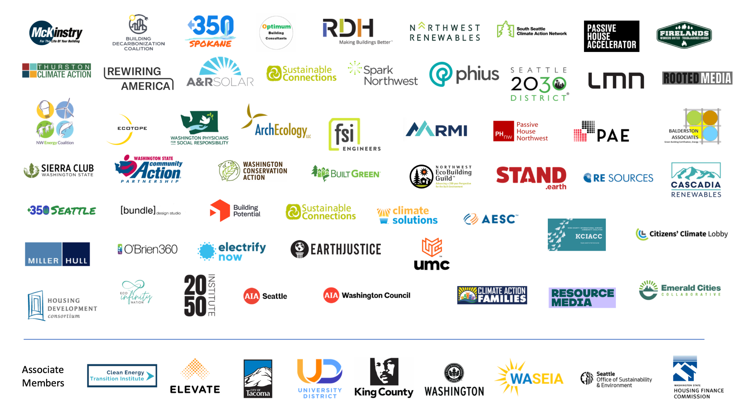
Notes:
Member organizations are the foundation of the alliance - diverse perspectives
Anti-poverty networks, affordable housing, enviros, building industry, health - local gov’s and more - we share a commitment to broaden partnerships as we work at the intersection of health, climate, poverty, housing, and labor issues.
It is inspiring to be part of this passionate and dedicated group.
We are one of the larger alliances bringing together national, regional, and local orgs; government partners, non profits, businesses, and are a respected resource for decision makers on building decarb.

Slide 5
Teams & Workgroups Organizing for Action
 | ENERGY CODE & STANDARDS Team | Strengthening and development of energy codes, building performance standards, and alignment of these policies.
 | STATE POLICY Team | Develops shared priorities and educates decision makers at the state level.
 | Implementation Workgroup | Lessons learned from implementation, to inform future recommendations and advocacy.
 | Wx Plus Health Workgroup | Identifies funding needs, structural changes, and advocacy opportunities to help scale Wx and maximize impact.
 | Rate Reform & Affordability | Protecting utility customers and affordability as we move forward on building electrification.
 | Livability Standards & Cooling | Improving access to cooling for renting populations.
 | FIELD Team | Organizers from partner organizations across the state coordinate and mobilize grassroots support.
 | LOCAL GOV’T STAFF Workgroup | WA local government staff explore building decarbonization policies and programs.
Equity First
AD HOC groups:
Embodied Carbon Policy
Workforce
Communications
Notes:
The alliance is a convener. Many meetings! That’s what it takes to build trust and foster collaboration.
We are nimble and responsive to the advocacy landscape, and adapt our workgroups and structure.
A recent example of this is the rate reform & affordability workgroup - identify policy solutions at the nexus of energy affordability and climate action.
As bills increase across the board—from housing, to food, to energy—climate action is also the best pathway to affordable utility bills for all Washingtonians.
Equitable building decarbonization is central to this effort.

Slide 6


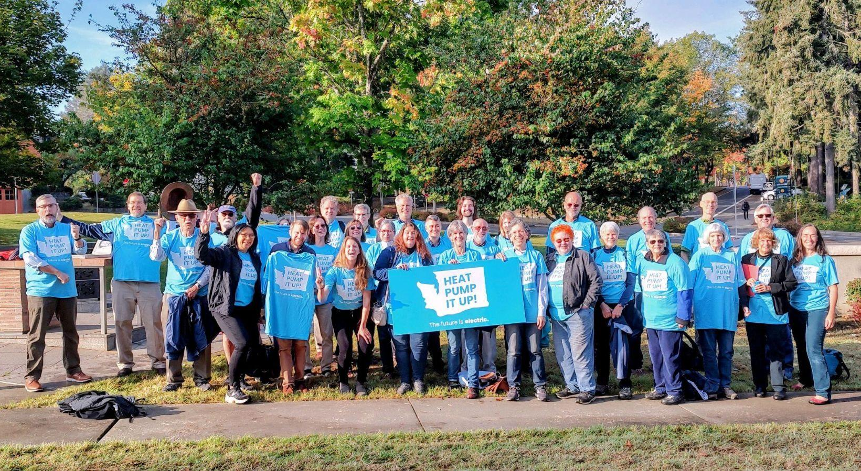


Shift Zero Role: Strategy, Collaboration, Coordination
Technical hub, stakeholder input
Develop messaging and educational materials
Organize broad coalition of stakeholders: health, anti-poverty, housing, climate, environmental justice, builders, engineers, grassroots
Mobilize testimony, sign on letters
Fast action response for defense

Slide 7
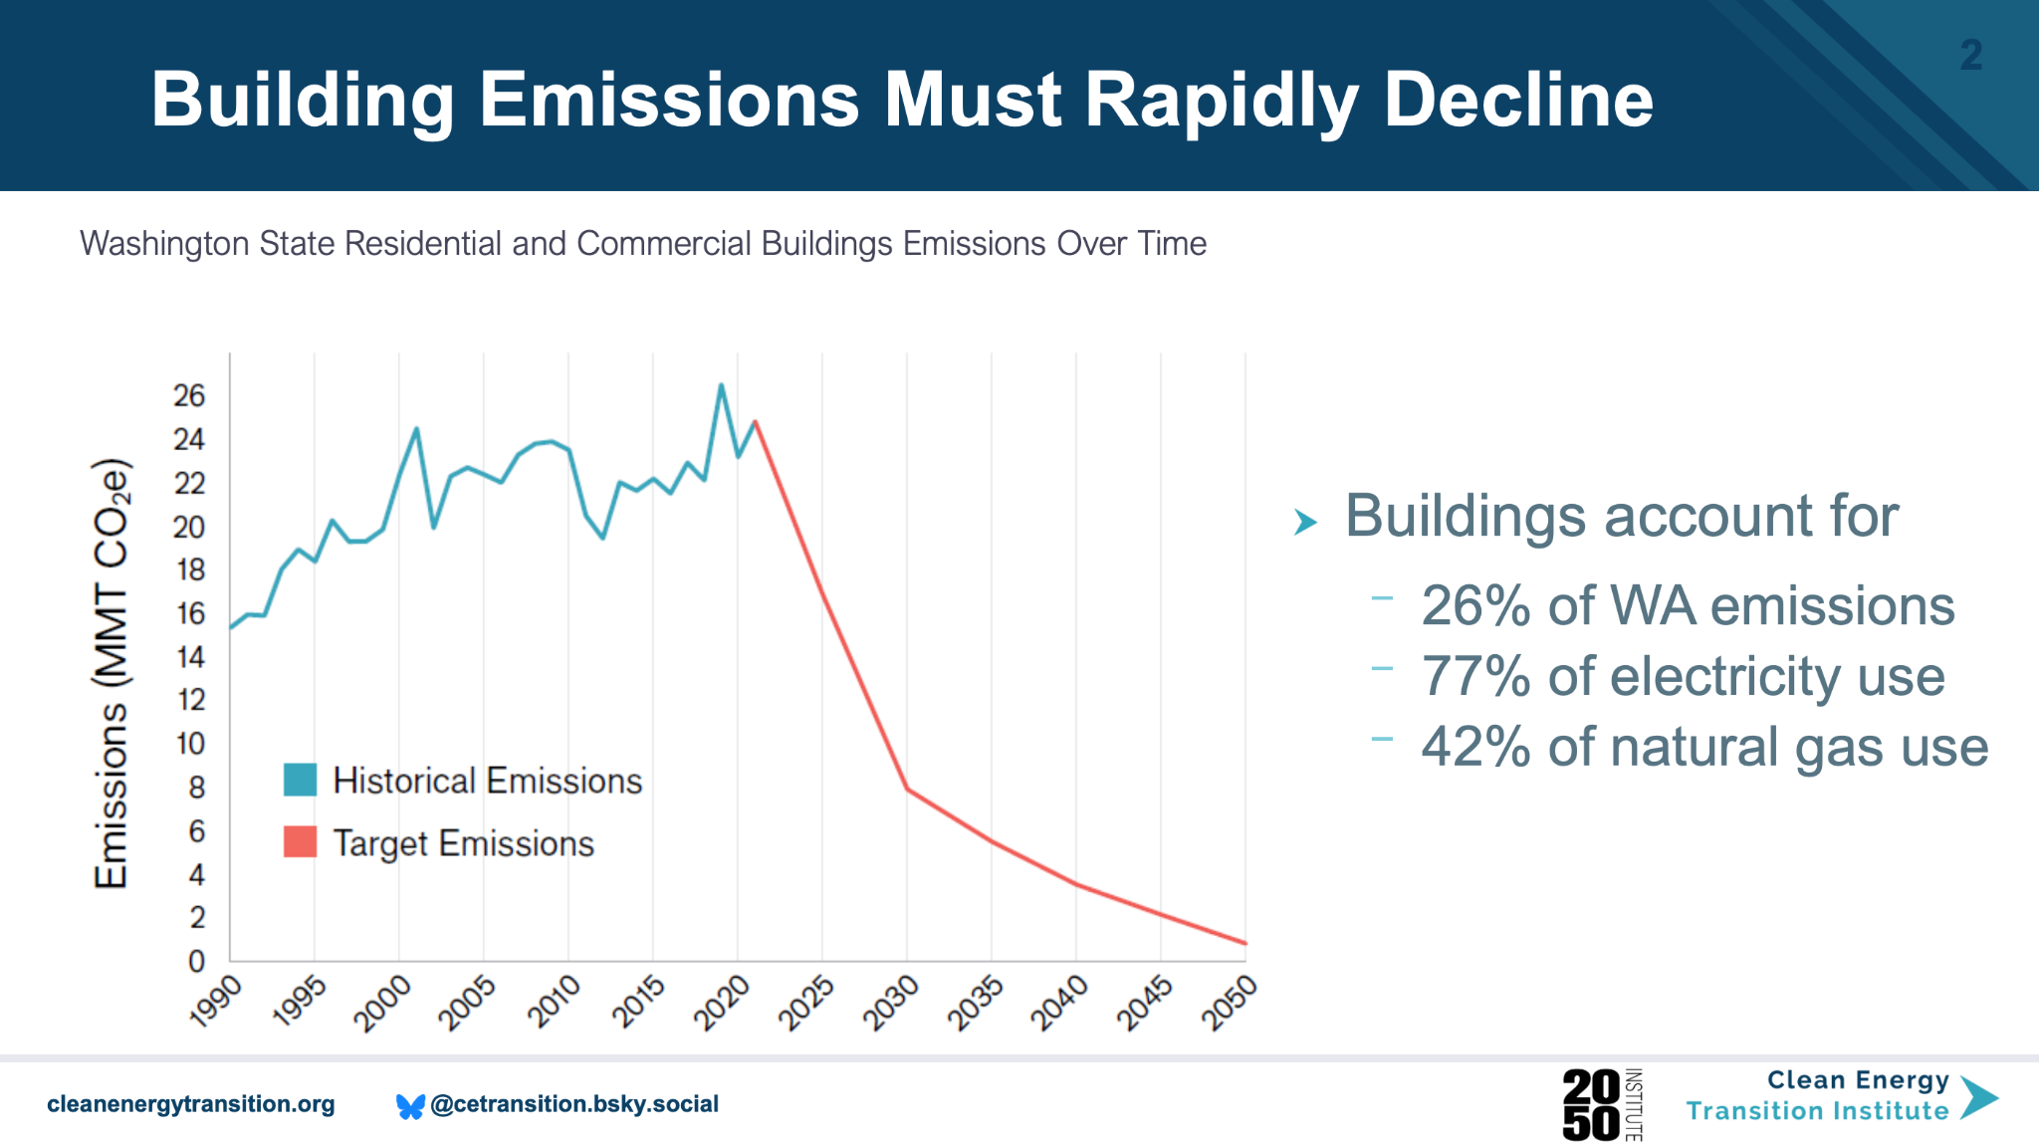
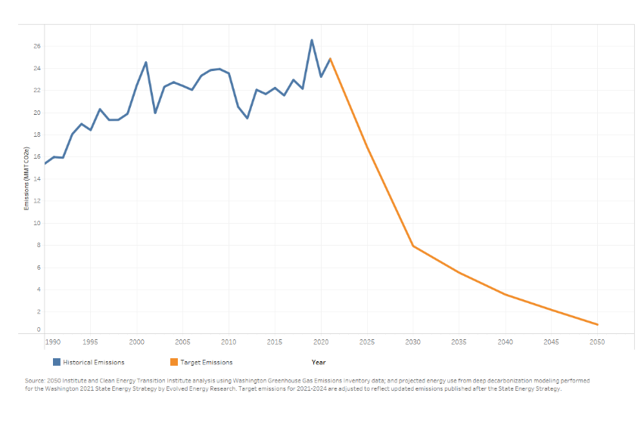
Building Emissions Must Rapidly Decline
Washington State Residential and Commercial Buildings Emissions Over Time
Notes:
Our challenge is illustrated very starkly in this graph.
Washington State aims to reduce greenhouse gas emissions at the scale and pace that the climate crisis requires:
statutory, economy-wide, net-zero emissions limits by 2050, the building sector must reduce emissions to nearly zero in just 25 years. This means no homes or buildings can be left behind.
To see how we're doing on this project, the graphic here shows historic emissions in blue on the left, and required emissions reductions in orange on the right
Buildings are significant piece of the puzzle - over a quarter of emissions.

Slide 8
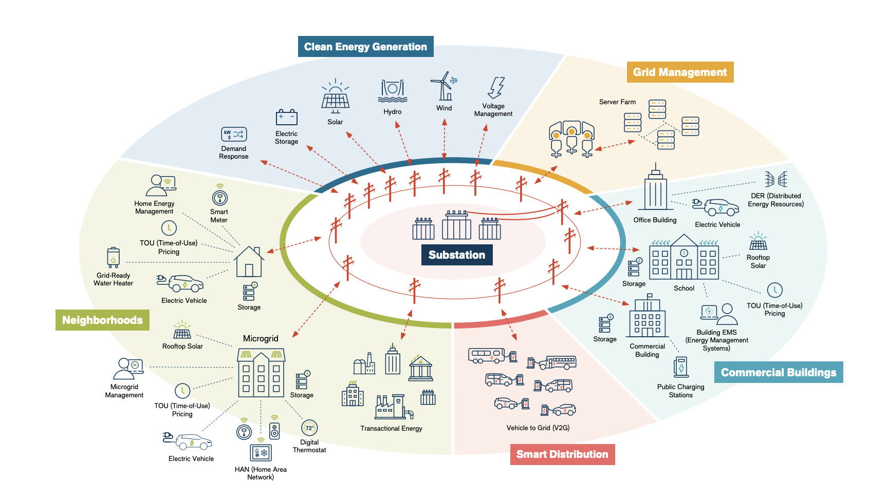
Buildings are central to the clean energy transition
Notes:
RK
Buildings are part of the challenge but integral to the solutions - a real opportunity -
The clean energy transition must include transportation, industry, buildings moving onto a clean electric grid.
Buildings consume vast amounts of energy, and compared with transportation or industry, has inefficiency available to mine.
WHY ARE BUILDINGS IMPORTANT FOR CLIMATE ACTION?
this is important for all of us to understand - because our buildings will be changing! these are the places we live and work in.

Slide 9
Washington’s Building Decarb Policy Framework
Energy Code Efficiency Mandate (2009) | 70% reduction in net annual energy consumption in new construction by 2031, compared to 2006 Washington State Energy Code (WSEC)
Clean Energy Transformation Act (CETA) (2019) | 100% clean electricity by 2045
Clean Building Performance Standard (2019) | Require energy performance standards for large existing commercial buildings. Expanded in 2022 to include benchmarking for multifamily and smaller commercial buildings.
Climate Commitment Act (2021) | Comprehensive program to reduce carbon pollution, cap greenhouse gas emissions, and generate funds for climate solutions.
City of Seattle’s Building Emissions Performance Standard (BEPS) (2023) | Requires most buildings larger than 20,000 square feet to reach net zero emissions between 2041 and 2050.
Washington State Energy Code (updated every 3 years) | Most climate friendly commercial and residential energy codes in the nation.
Programs operated by state and municipal governments, utilities, non profits | E.g. Home Electrification and Appliance Rebates, Weatherization, WA Green Bank
Notes:
Washington is leading the nation with climate action policy: A strong framework to support the clean energy transition over the next couple of decades.
This list highlights some of the landmark policies driving the trajectory
Overall picture:
Clean electric grid underpinning this transition
cap on pollution and critical revenue to fund climate solutions
sticks and carrots for new and existing buildings.
Economy-wide policies like Clean Energy Transformation Act (CETA) and Climate Commitment Act (CCA)
Building sector–specific policies at the state or local level
The only policy applying to all buildings is the state energy code - mostly applies to new construction but also has requirements for existing buildings. Deepa will dive into what’s happening with the energy code right now…

Slide 10
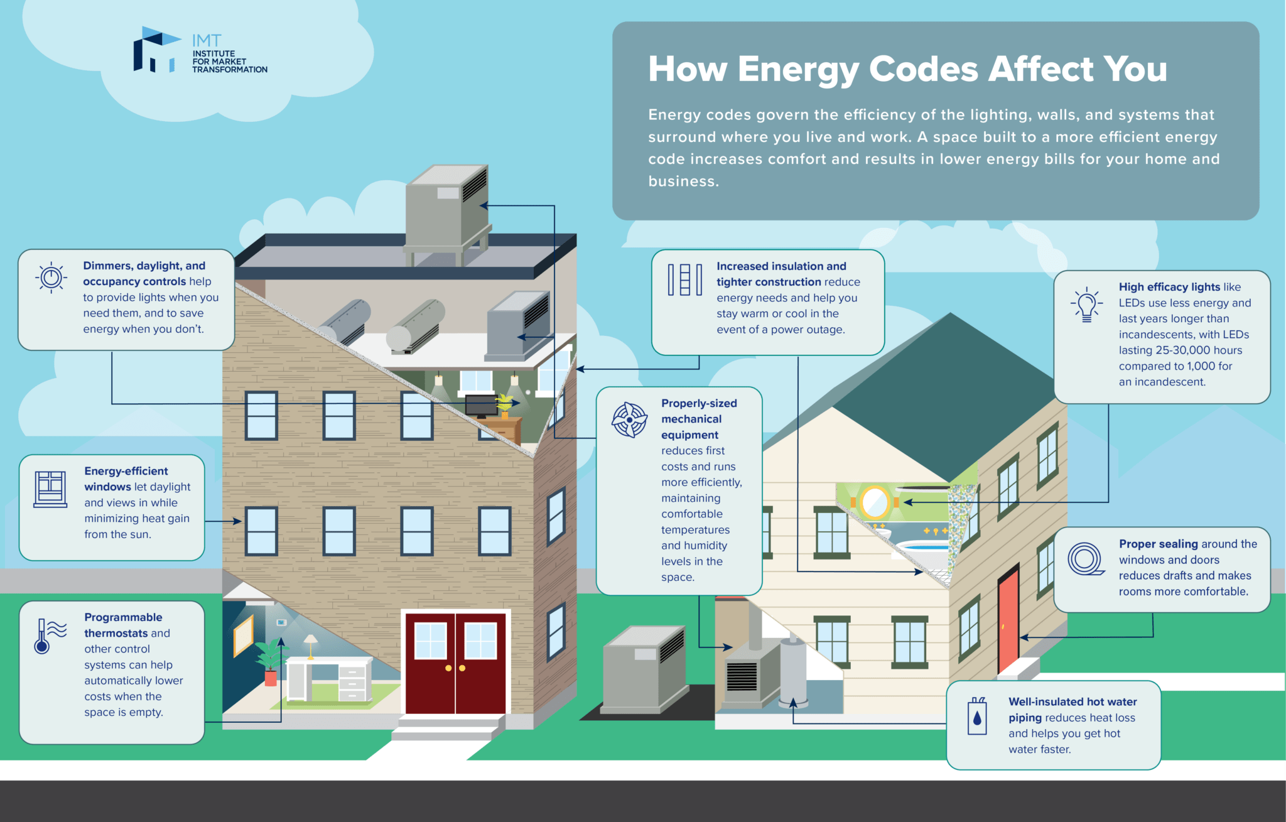
Energy Code Advocacy
Notes:
deepa

Slide 11
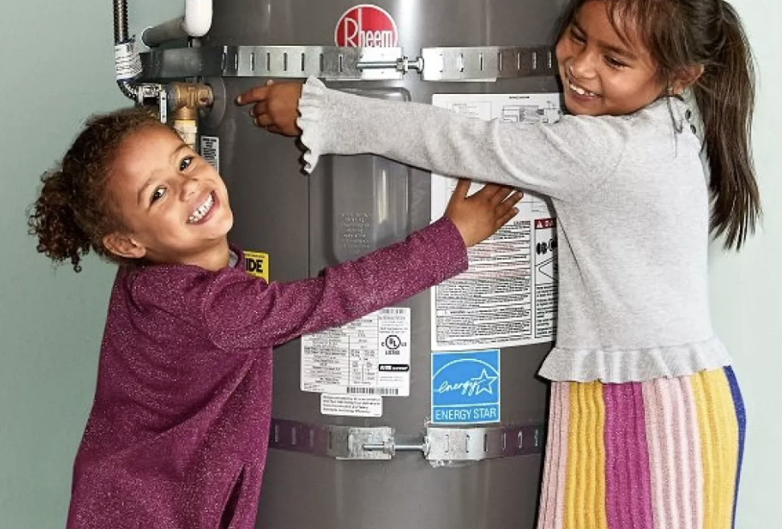
Energy codes are more than just building standards.
Powerful tool for driving climate action and clean energy transition
Health benefits - improves air quality
Increases resilience - access to cooling
Long term affordability - energy cost savings
Notes:
Climate goals. Energy use from buildings makes up approximately 27% of greenhouse gas emissions
More efficient buildings mean:
Lower utility costs for residents and tenants
Healthier homes and buildings with improved indoor air quality
More responsible use of our existing clean energy resources, reducing needs for new power generation as our population grows
Clean electricity currently needed for buildings is made available to replace fossil fuels used in vehicles and space and water heating
Reduced energy use, which will help the State meet its carbon reduction targets

Slide 12
Washington State Energy Code Update is Underway
Regulates energy use in newly constructed and substantially renovated buildings in Washington
Washington has two energy codes:
  Residential code
  Commercial code
Updated every 3 years: throughout 2025-2026, we are in the “2024 Code Adoption Cycle”

Slide 13
WA State Building Code Council leads a rigorous code adoption process
Proposals are submitted; Technical Advisory Groups review
Public provides comment
Code sits through legislative session
Jan - Aug 2025
May - Jun 2026*
Jan - Apr 2027
Apr 2026*
Aug 2026*
May 3, 2027
SBCC advances codes to public comment
SBCC reviews, votes on changes
2024 WA State Energy Code implemented
*currently tentative
Notes:
This year, there are 148 proposals in the commercial energy code update
17 TAG meetings!

Slide 14
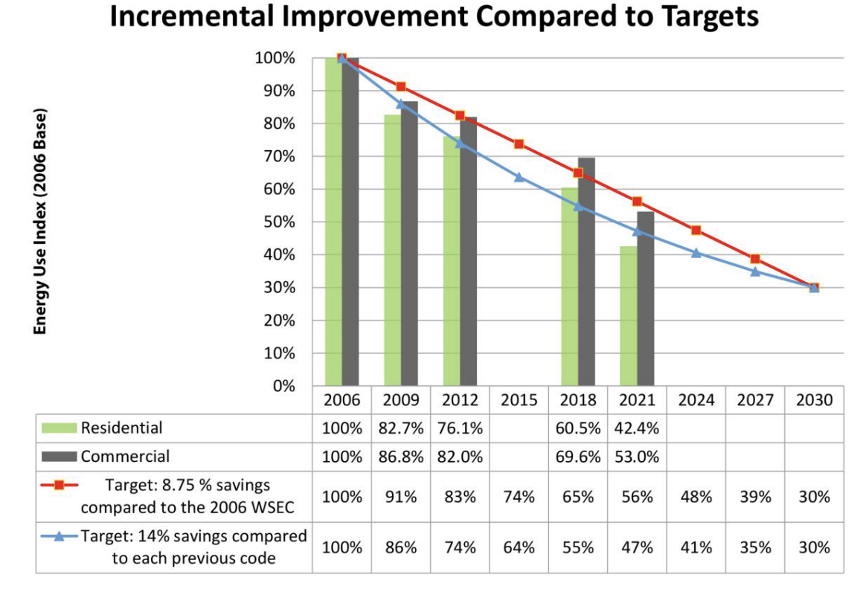
Where are we trying to go?
Build smart from the start
Meet legislative efficiency mandates
Blueprint for the nation
We only have 2 cycles to go
Notes:
Washington legislature set a target for new buildings to be 70% more efficient by 2031 than 2006 levels

Slide 15
2024 Commercial Code
Proposals supported by Shift Zero
Proposal | # | Description | Required?
AC to heat pump replacement | 209 | Replacement of small rooftop A/C units with heat pumps when they fail | No
High-performance equipment replacement | 268 & 270 | Replacement of HVAC and water heating with heat pumps when fail | No
HPHW capacity increase* | 268 | Heat pump hot water heaters in new buildings sized for 100% of building’s needs | Yes
Notes:
AC to Heat Pump
Replacing failed A/C with heat pumps of the same capacity doesn’t require electrical upgrades, making it a cost-effective way to electrify space heating in small commercial buildings. The replacement heat pumps provide heating support during the winter, lowering energy usage since heat pumps are much more efficient than gas furnaces. If the building owner chooses not to install heat pumps, they will have to make other improvements that achieve the same energy efficiency in the building as heat pumps do, reducing energy waste.
High-performance replacement equipment
Same as AC to heat pump but for HVAC and water heating.
Increasing sizing of HPHW capacity
The 2021 code required that heat pump hot water heaters be used in most new commercial buildings, but only required them to provide 50% of the building’s hot water needs at 40 degrees outside. This would increase the sizing to cover 100% of the need.

Slide 16
2024 Commercial Code (continued)
Proposals supported by Shift Zero
Proposal | # | Description | Required?
Electric readiness | 263 | Electric infrastructure in commercial kitchens | Yes
Fossil fuel compliance path | 279 | Combination of fossil fuel compliance path with prescriptive path | Yes
Removing CMU wall exemption* | 264 | Insulation requirements for concrete masonry units (CMU) walls | Yes
Notes:
Electric-Readiness for Commercial Kitchens
Requires commercial kitchens with gas-fired cooking equipment in new buildings to provide a full electrical power supply and panel to the kitchen so that any cooking appliances can be replaced with highly efficient electric appliances in the future.
Elimination of Fossil Fuel Compliance Path
The 2021 energy code, due to a court decision CRA v Berkeley, included a separate compliance pathway for fossil fuel heating and water heating. The FF path required extra efficiency credits to make up for the lack of energy efficiency when FF appliances are used. This proposal combines the Fossil Fuel pathway with the other prescriptive pathway, and it is now entirely based on site energy use. Since heat pumps are very efficient, they are inherently incentivized over fossil fuels and electric resistance.
Eliminate CMU wall exemption
Under current code, concrete masonry unit (CMU) walls are exempted from meeting the insulation requirements that other walls have to meet, which means those buildings lose heat more easily and require more energy to heat. Proposal 264 eliminates that exception, ensuring the buildings using this material are well-insulated and do not use as much heat, which then lowers heating costs and reduces energy waste. Other states like Oregon and California have eliminated this exception in their codes, and the City of Seattle has never allowed it, so Washington as a whole can easily eliminate this exception.

Slide 17
2024 Commercial Code (continued)
Proposals supported by Shift Zero
Proposal | # | Description | Required?
Window glazing | 176 | 20% of window space in a building to have triple glazing | Yes
EnergyStar appliances | 173 | New cooking appliances in new commercial kitchens to be EnergyStar rated | Yes
Interior LPA | 234 | 9% reduction in lighting power allowance (LPA) | Yes
Water pipe insulation | 269 | 1” thickness added to pipe insulation minimum for circulating domestic hot water loop piping | Yes
Notes:
Triple glazing for 20% of window space
Since windows are some of the biggest sources of heat loss in buildings, this proposal requires that 20% of window space in a building have triple glazing, which increases the energy efficiency of the building and ensures that less heat is lost through windows. New forms of “thin triple” glass make this requirement very economical to implement; additionally, 20% is a small amount, so, for example, a one-bedroom apartment could meet this requirement just by having their bedroom window triple glazed.
EnergyStar commercial cooking appliances
In new commercial kitchens, fryers, steamers, dishwashers, and holding cabinets must be EnergyStar rated, unless used appliances are purchased. This proposal saves a significant amount of energy, especially for fryers which are highly inefficient, reducing energy waste.
Interior lighting power allowance (LPA)
An interior lighting power allowance is a maximum limit on the amount of power that can be used for lighting in a building, so more stringent allowances help reduce wasted energy. Proposal 234 reduces the current LPA by 9%, as the result of a study by PNNL that showed this improves efficiency to keep the code on target while remaining cost-effective.
Water pipe insulation
Proposal 269 requires an additional 1” in the thickness of pipe insulation for circulating domestic hot water loop piping. Along with proposal 174 that requires a more accurate measurement of water demand, this will reduce pipe sizes, not only increasing energy efficiency but also reducing construction costs and ensuring that water is heated faster for tenants to use.

Slide 18
2024 Residential Code
Proposals supported by Shift Zero
Proposal | # | Description | Required?
AC to heat pump replacement | 019 | Replacement of central ducted A/C systems with heat pumps when they fail | No
Electric readiness | 018 | Electric infrastructure near water heating, dryers, or cooking | Yes
Notes:
Incentivizing Heat Pump Use
Similar to AC to heat pump in commercial code, but for central units.
Electric Readiness
Every fossil fuel water heater, dryer, or cooking appliance in new homes must have a branch circuit sized for a future electric version of the appliance as well as dedicated space on the main electrical panel, so that fossil fuel appliances can be replaced with highly efficient electric appliances in the future if the homeowner chooses.

Slide 19
2024 Residential Code (Credits Table)
Proposals supported by Shift Zero
Proposal | # | Description
House size | 035 | 10 house size categories, increased credits for largest
Window insulation | 036 | Decrease in U-factor from 0.28 to 0.27
Maximum air leakage | 037 | Decrease in air changes per hour (ACH) from 4.0 to 3.0
Balanced ventilation for heat recovery | 038 | Balanced ventilation for new homes in eastern Washington
Duct spaces | 034 | Heating and cooling ducts in conditioned space
Notes:
New homes are required to meet a certain minimum level of energy efficiency, which they do by achieving efficiency credits for various improvements, which are listed in a table in the energy code. Homeowners can choose which improvements to make as long as they are overall achieving the number of credits required. Several proposals this year increase the overall number of credits that homeowners and builders are required to achieve, which reduces energy waste and ensures that they are choosing modern, efficient, state-of-the-art practices and appliances. These proposals also ensure that we are on track to reduce overall energy use in new construction 70% by 2031, which is required by state law.
Reevaluating credits based on house size
Proposal 035 divides house sizes into ten categories, decreasing the credits required for smaller houses and stepping up to a higher number of credits for very large houses.
Improving window insulation
The U-factor is a measure of how well-insulated a window is; a lower U-factor means that the window is better insulated and loses less heat. Proposal 036 improves residential window insulation by requiring a U-factor of 0.27 instead of 0.28 as it is currently.
Maximum air leakage
Air Changes per Hour (ACH) is a measure that quantifies how much air leaks from a building. A higher ACH means that more air leaks out of your house within an hour.
Proposal 037 improves building air leakage from 4.0 ACH to 3.0 ACH, ensuring that less heat is wasted and that homeowners will be more comfortable.
Balanced ventilation for heat recovery
Proposal 038 requires that in eastern Washington, new homes have balanced ventilation that reduces energy waste, typically through heat recovery ventilation, which uses heat from building exhaust air to heat the fresh air that is entering a building from outside. Proper ventilation in a home helps maintain healthy indoor air by removing stale air, controlling humidity, and preventing the buildup of indoor air pollution, which is crucial during wildfire smoke events for safety from airborne diseases like COVID-19. Heat recovery systems can recover and reuse heat that would otherwise be lost during ventilation, helping to reduce energy waste and lower heating and cooling bills. This proposal is only for eastern Washington because the proponent found that it would not be as cost-effective in the milder climates of western Washington.
Ducts in conditioned space
Currently, ductwork can be located in parts of the house that are unconditioned, meaning that those spaces do not have to be heated or cooled by the building’s HVAC system (for example, basements or attics). Proposal 034 requires that duct systems for heating and cooling are all located in conditioned spaces, meaning that if any air leaks from the ducts, it is not wasted on spaces that do not need heating or cooling.

Slide 20
2024 International Building Code (IBC)
Proposals supported by Shift Zero
Proposal | # | Description | Required?
Embodied carbon (option #1) | 118 | Three pathways to measure and reduce EC in new builds and alterations: product compliance pathway, whole building lifecycle assessment, or building reuse pathway | No
Embodied carbon (option #2) | 118 | Only whole building lifecycle assessment pathway and only new construction | No
EV-readiness | n/a | Change to EV-ready MFH requirements | Yes

Slide 21
Future Energy Code Advocacy
Building performance standard & code alignment
Performance path for residential code
Embodied carbon
Passive survivability
Appliance standards
EV connectivity
Existing building energy efficiency
Demand response
Weatherization/retrofitting
Improved/more nuanced existing building renovation energy code
Updated standards for building-scale batteries
Water efficiency
Smart panels
What else?
Upcoming Code Updates: Local Commercial Energy Code, City of Seattle
Notes:
Deepa
Balancing energy efficiency, resilience, renewable energy production, climate goals

Slide 22

2026 Legislative Session
“Short” Session: January 12 - March 12, 2026
Notes:
Rachel

Slide 23
Shift Zero Policy Priorities
Keep energy bills affordable, improve housing conditions, and reduce climate pollution from buildings
HB 2338 / SB 6223 Community Scale Weatherization
Update Washington’s successful Weatherization Plus Health (Wx+H) program allowing weatherizing agencies to reach more homes faster and at lower cost.
HB 2265 / SB 6200 Protecting Tenants From Periods Of Extreme Heat (safeandcoolwa.org)
Helps renters safely weather the hotter summers and wildfire smoke, by affirming tenants' right to install cooling in their homes, and in the case of HB 2265, provide protections from evictions during periods of extreme heat and push the state towards a requirement of getting cooling into every home.
HB 2515 / SB 6171 Data Centers, Environmental Protection, and Affordability
Ensure that data center growth has guardrails that deliver grid reliability, affordability, and environmental protections. Includes a facility fee that data centers pay to support energy assistance, weatherization, low-income home electrification, and related readiness upgrades.
Notes:
Rachel
This proven program keeps housing affordable, creates family-wage careers, reduces energy bills, and improves health and safety for thousands of Washingtonians living on low incomes.

Slide 24
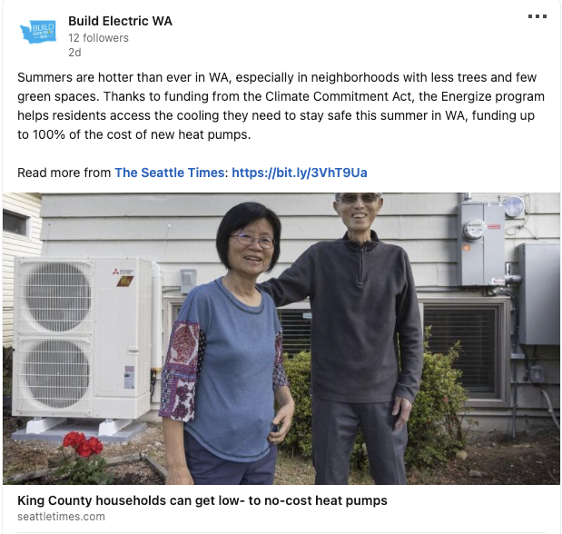
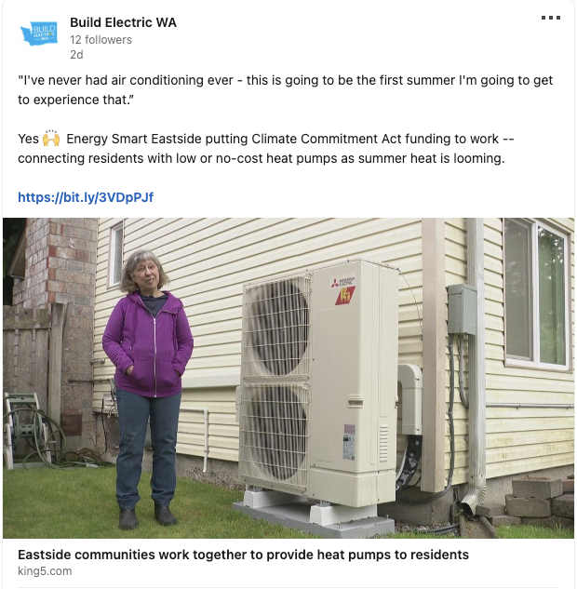
Budget Advocacy
Climate Commitment Act Funding for Equitable Clean Energy Upgrades and Healthy Home Repairs
$50M to restore Home Electrification and Appliance Rebates Program (HEAR) funding at prior levels, and $33M to restore State Home Energy Assistance Program (SHEAP)
$10M to restore Affordable Housing Multifamily Efficiency grant program
$25M for the WA State Green Bank: Leveraging CCA dollars for clean energy upgrades across all types of buildings
Defending climate dollars
Keep Climate Commitment Act funds for their intended purpose: reducing climate pollution, expanding affordable clean energy and energy efficiency, and strengthening communities in the face of rising climate impacts.
Notes:
Rachel
Both SHEAP and HEAR programs support climate justice, energy affordability, and equitable clean energy upgrades in critical and complementary ways. Consistent funding is needed to meet the needs of vulnerable households across Washington.
$10M to restore Affordable Housing Multifamily Efficiency grant program
Flexible incentive funding to enable multi-family affordable housing to invest in energy efficiency and electric building upgrades. Lower income apartment building residents deserve to live in clean and healthy, electric buildings.

Slide 25
Code Related Bills
HB 2381: Concerning performance-based building codes for low-rise residential buildings.
Attempts to weaken and roll back code
HB 2486 would:
  Allow building code officials to approve prior, less expensive provisions in code when a measure is deemed “economically impractical”
HB 2141 would:
  Prohibit innovation by freezing all building code updates for 10 years, and then extending update cycles from 3 to 6 years
  Repeal legislative energy efficiency mandate for the code
Notes:
Deepa

Slide 26
Calls to Action for Building Industry Advocates
Building industry voices are powerful advocates. Decision makers need to hear from you!
“We can do this”: technical perspective on proven technologies
Share real world success stories
Affirm consumer demand
Voices from Eastern Washington and rural areas are especially helpful
Ways to plug in
Subscribe to Shift Zero newsletter
Become a Shift Zero member organization
Participate in a Shift Zero Team
Apply to join State Building Code Council Technical Advisory Groups
We have talking points, templates, and resources to help you advocate.
2024 WSEC Advocacy
May-June: Submit public comment, technical letters of support
June: Verbal testimony at public hearings, in person or virtually
Legislative Advocacy
Email your legislators with support for Affordable, Efficient, Healthy Homes & Buildings
Notes:
Rachel - Jason
We need collaborative leadership on this journey - in your roles and capacity how can you contribute to climate solutions in buildings?
overall goals - clean air, protect health, children be able to be healthy and prosperous.

Slide 27
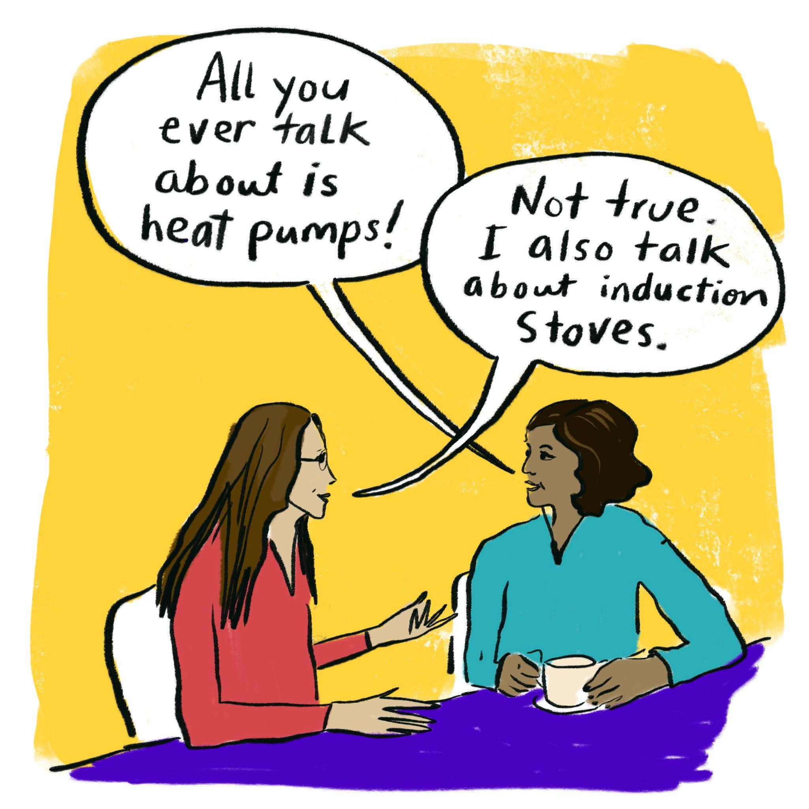
Q&A
Thank you!
Rachel Koller, Shift Zero, rachel@shiftzero.org
Deepa Sivarajan, Climate Solutions, deepa.sivarajan@climatesolutions.org

